Slide 1

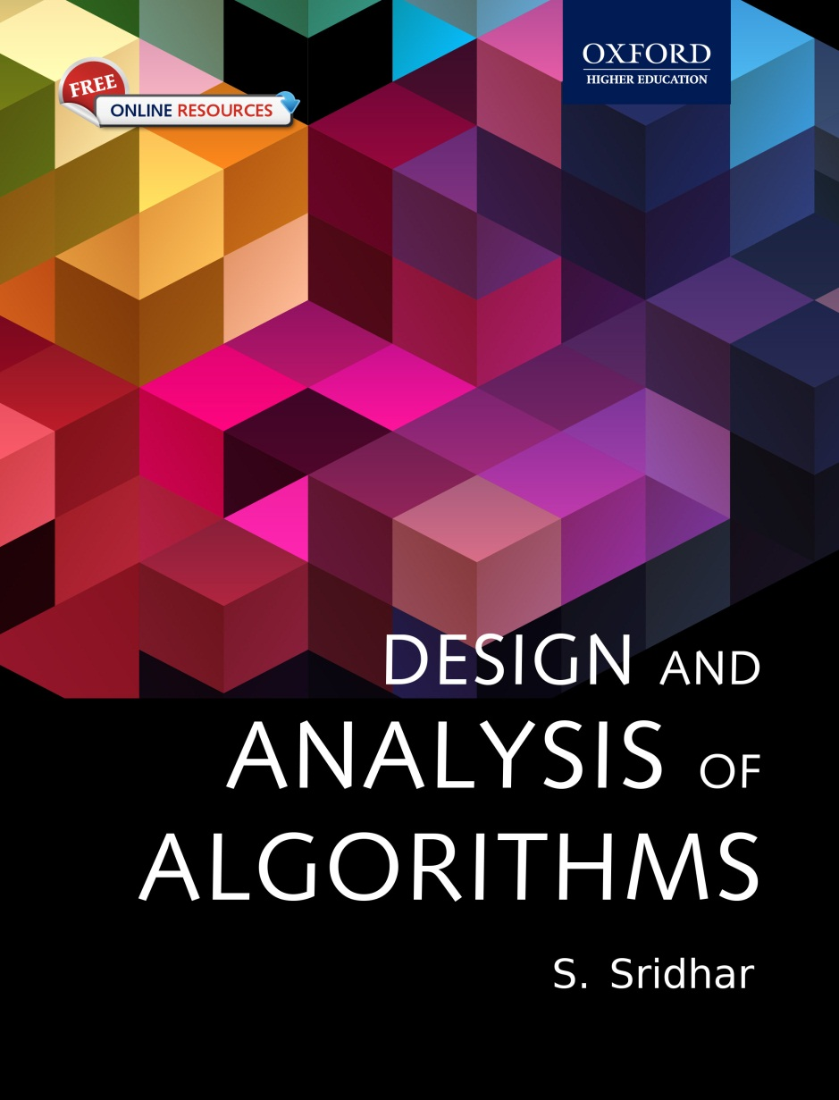
Design and Analysis of Algorithms
S. SRIDHAR

Slide 2
Chapter 4 Recursive Algorithm Analysis

Slide 3
Chapter Objectives
Basics of recurrence equations
Formulation of recurrence equations
Solving recurrence equations using different methods
Basics of divide-and-conquer recurrences
Master theorem for solving recurrence equations
Conditional asymptotics

Slide 4
Skills required
To analyze a recursive algorithm, two skills are basically required:
1. Formulating a recurrence equation
2. Solving the recurrence equation to understand the behaviour of the program

Slide 5
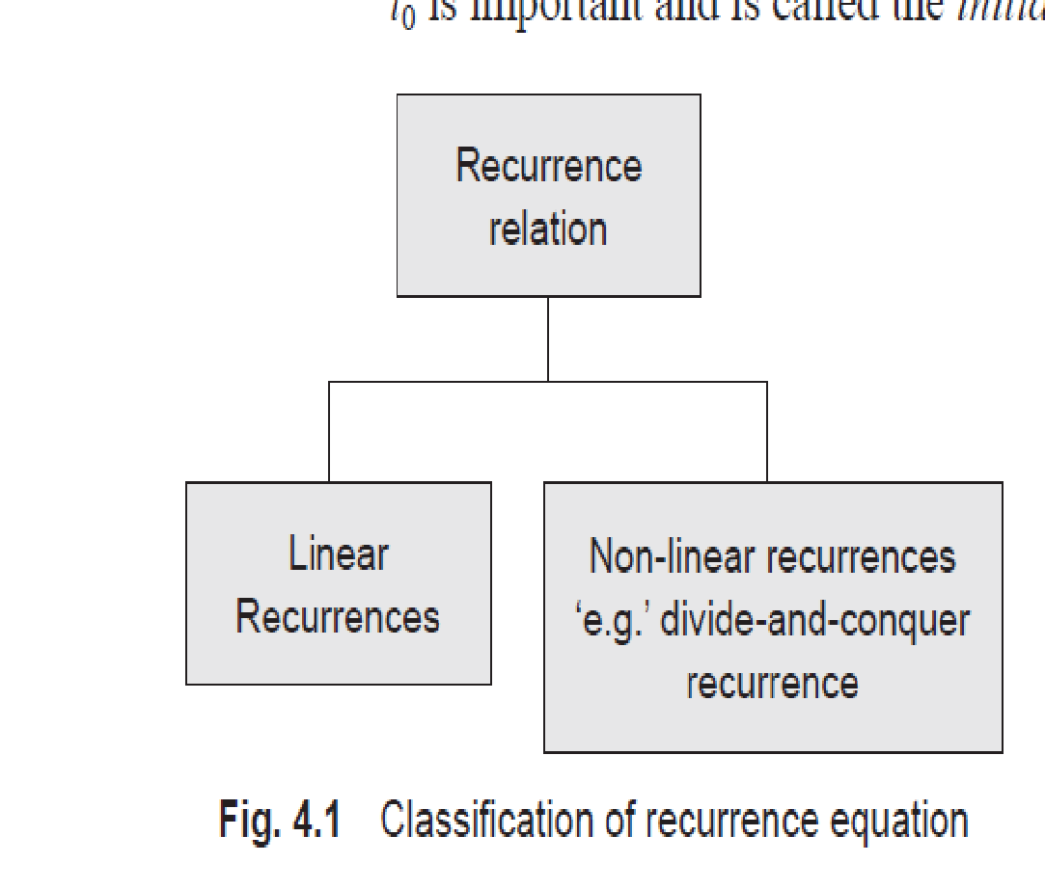
Types

Slide 6
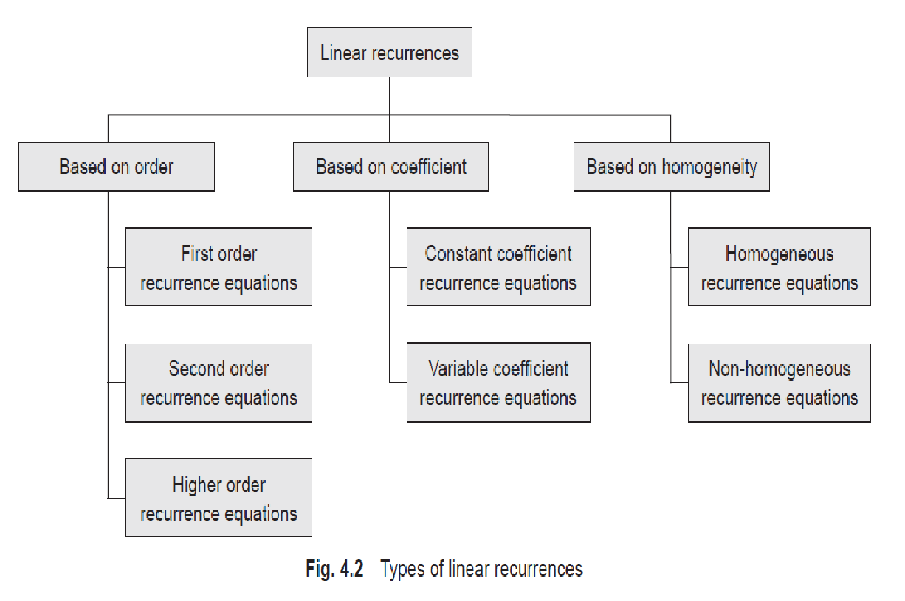
© Oxford University Press 2015. All rights reserved.

Slide 7
Constant vs Variable Coefficient
In the generic linear recurrence equation a0tn + a1tn−1 + … + aktn−k = f(n), the terms ai can be constants or variables. Based on this fact, one can classify linear recurrence equations into two types: linear recurrence equations with constant coefficients and those with variable coefficients.
Consider the following linear recurrence equation:
tn = n × tn−2
This recurrence equation is dependent on the variable n and does not have constant coefficients.
© Oxford University Press 2015. All rights reserved.

Slide 8
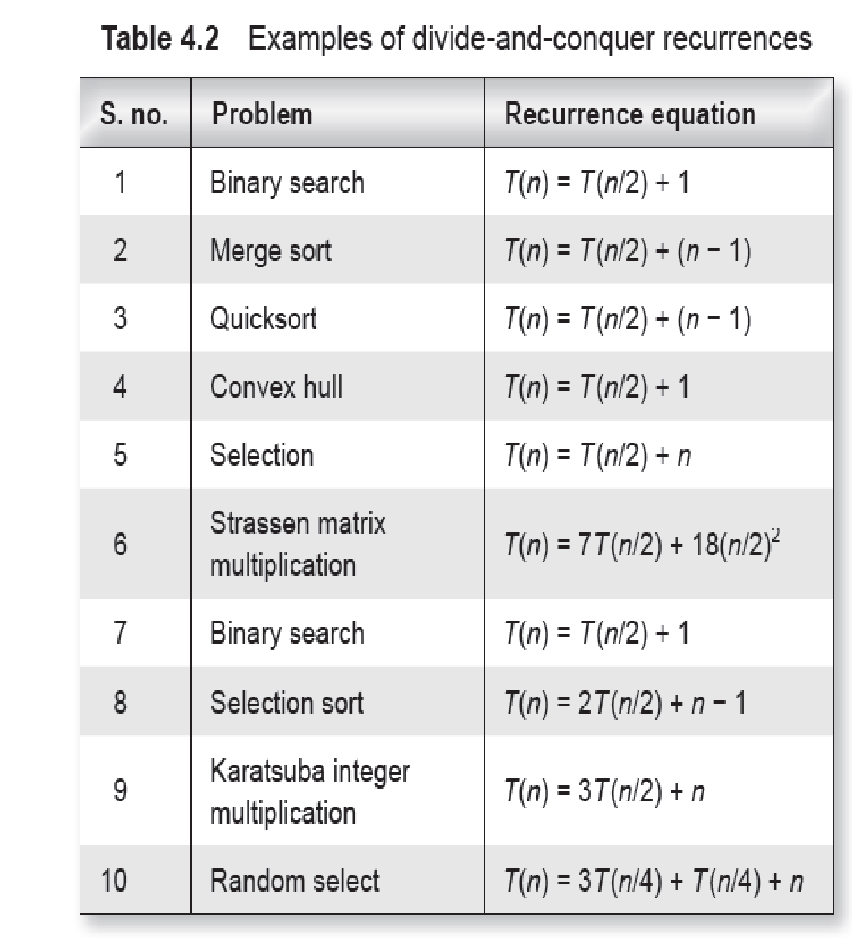
© Oxford University Press 2015. All rights reserved.

Slide 9
Analysis of Framework
For example, for the sequence 1, 4, 7, 10, …, one can write the recurrence equation as follows:
T(n) = T(n − 1) + 3
T(0) = 1
It can be observed that T(0) = 1 is a base condition. From this equation, T(1) can be generated as T(0) + 3 = 4 and T(2) as T(1) + 4 = 7. Similarly, all terms of the sequence can be generated.
The preceding equation can be denoted as follows:
tn = tn−1 + 3
t0 = 0

Slide 10
Example
Example 4.1 What is the recurrence equation for the sequence 1000, 2000, 4000, 8000, …?
Solution
t0 = 1000
t1 = 2000 = 2 × 1000 = 2 × t0
t2 = 4000 = 2 × 2000 = 2 × t1 = 22t0

∴, one would guess tn = 2 × tn−1 or tn = 2n × t0
It can be observed that tn = 2 × tn−1 is the required recurrence equation of this problem. We will discuss later that tn = 2n × t0 is the actual solution of the recurrence equation as it is non-recursive.

Slide 11
Example
Design and Analysis of Algorithms
Example 4.2 Find the recurrence equation and the initial condition of the following sequence:
7, 21 4 , 63 16, 189 64 , …
Solution Let the initial condition be t0 = 7. Let us observe the patterns. Let us calculate the ratios of the successive elements as follows:
t1 t0 = 2147 = 21 28 = 34; t2 t1 = 63 16 21 4 = 63 16 × 4 31 = 34; t3 t2 = 189 64 63 16 = 189 64 × 16 63 = 34
Therefore, one can predict that tn tn–1 = 34
Therefore, tn = tn−1 × 34
Thus, one can conclude that the recurrence equation is tn = tn − 1 × 34.

Slide 12
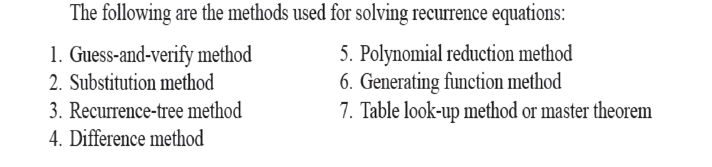
Techniques for Solving

Slide 13
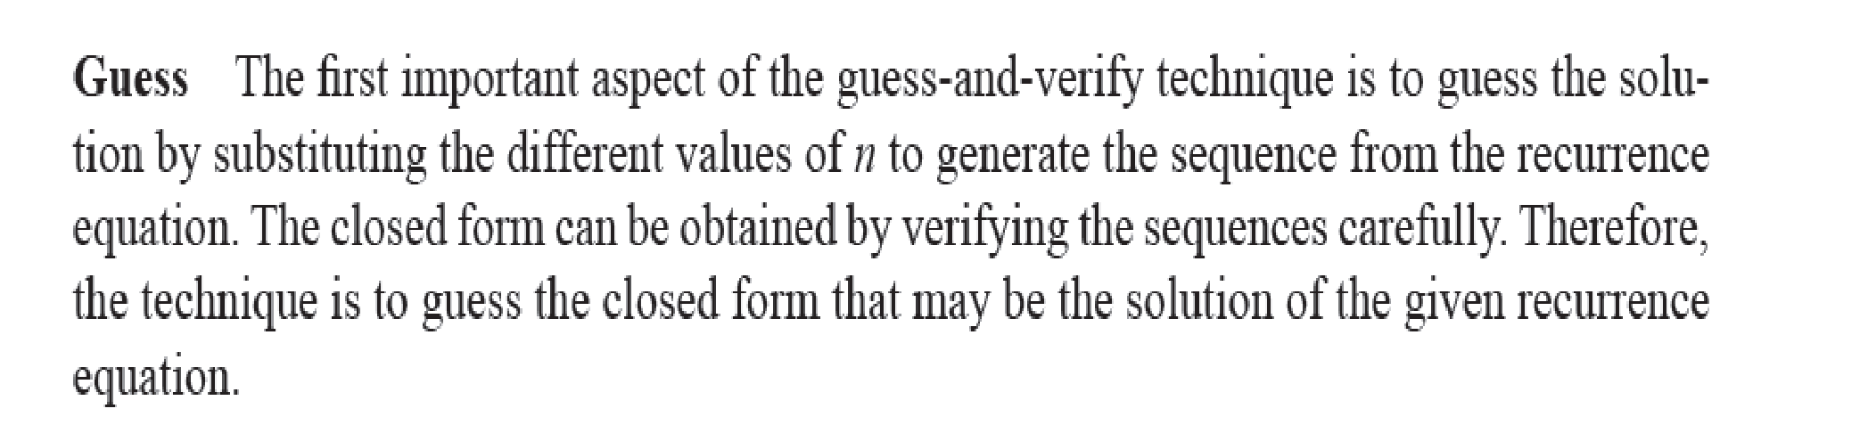
Guess and Verify Methods

Slide 14
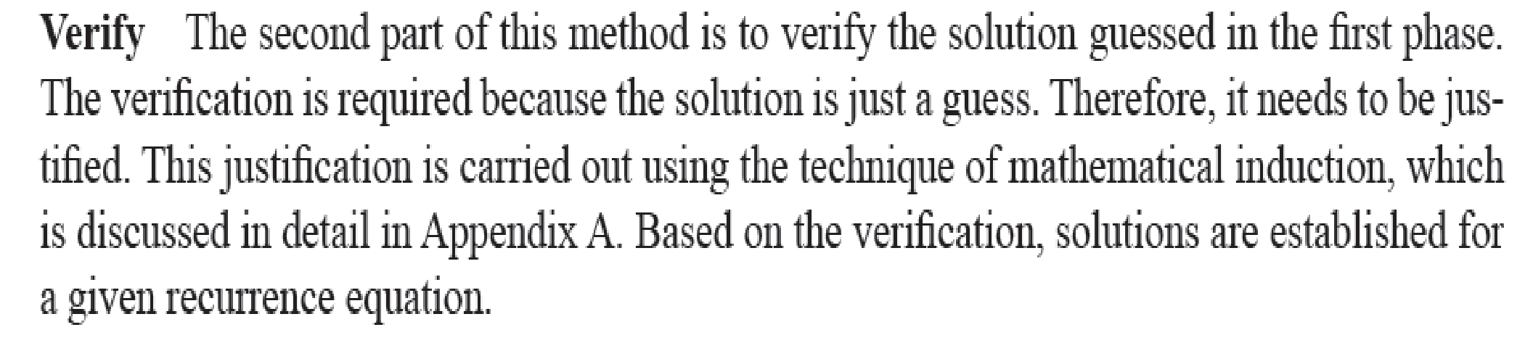
Guess and Verify Methods

Slide 15
Example
Example 4.7 Solve the recurrence equation tn = tn−1 + 2 t0 = 1 using the guess-and-verify method.
Solution As said earlier, first make a guess of the solution and then verify it.
Guess: For making a guess, use different values of n in the recurrence equation as follows:
t0 = 1
t1 = t1−1 + 2 = t0 + 2 = 3
t2 = t2−1 + 2 = t1 + 2 = 5
t3 = t3−1 + 2 = t2 + 2 = 7

The sequence obtained (1, 3, 5, 7, …) indicates that every term differs from the previous one by 2. This is an odd-number series. Therefore, one can guess that the solution for the recurrence equation would be 2n + 1. As this is a non-recursive formula in terms of n, this can be a solution. To confirm this, one should verify the guess.

Slide 16
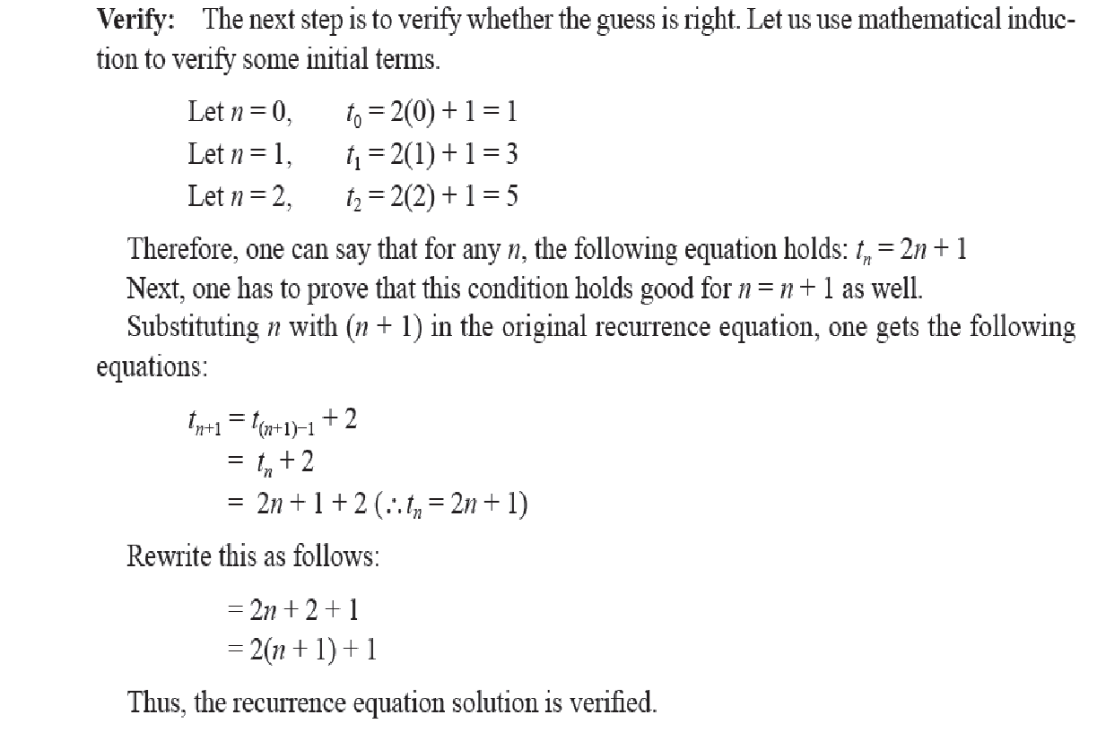
Examples of Input Size

Slide 17
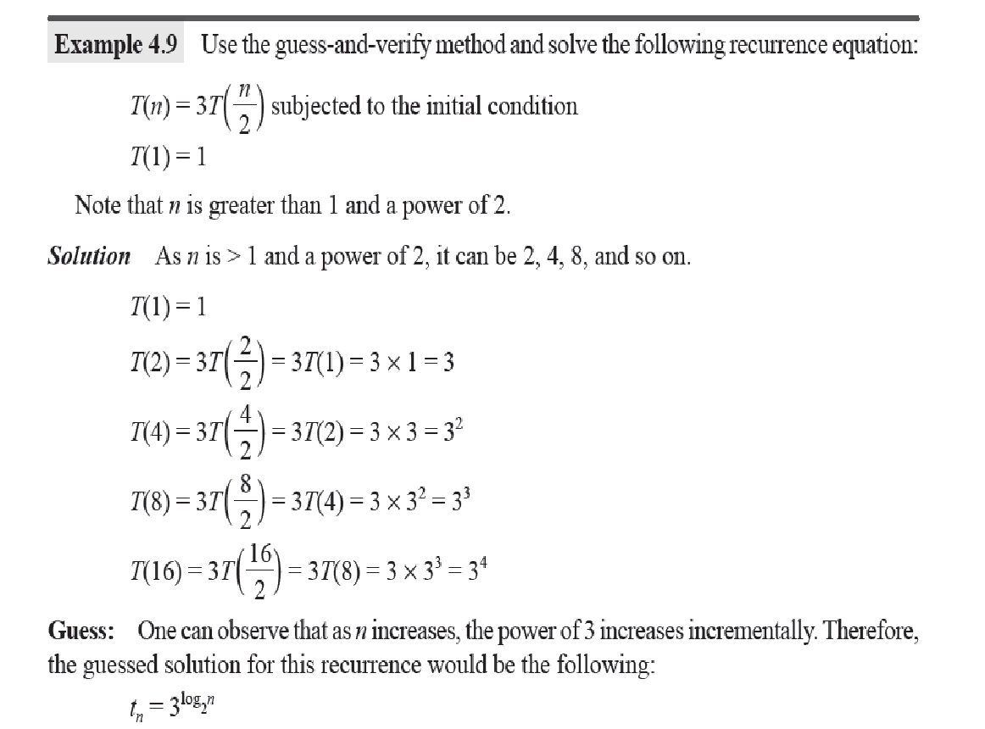

Slide 18
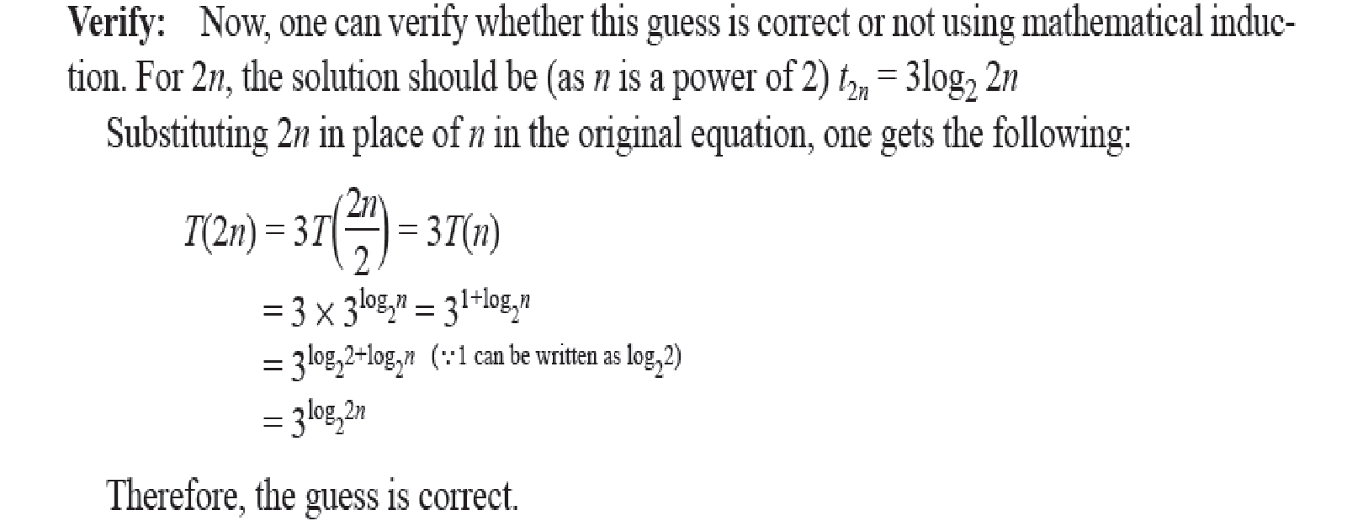

Slide 19
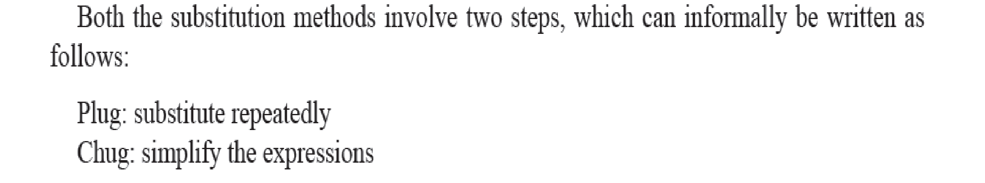
Substitution method

Slide 20
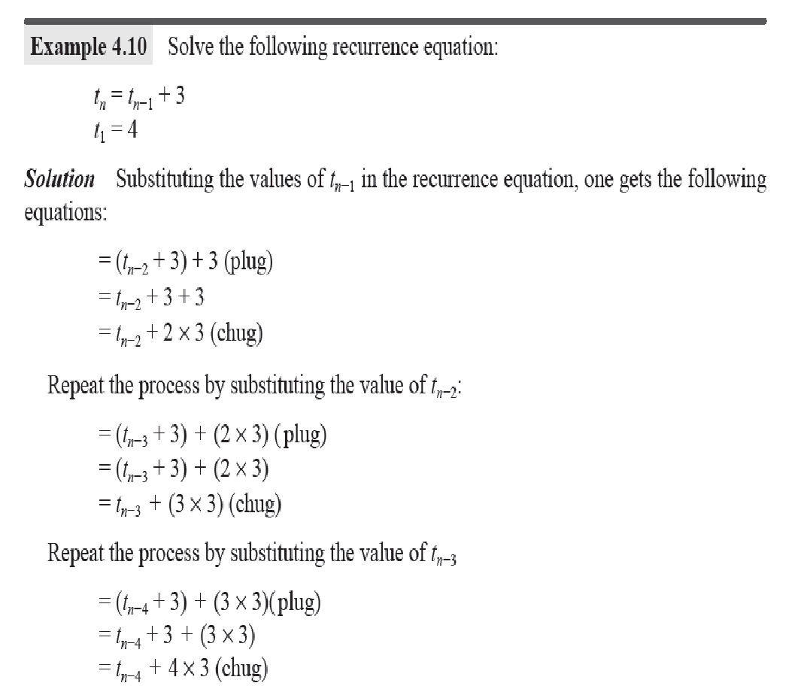
Backward Substitution

Slide 21
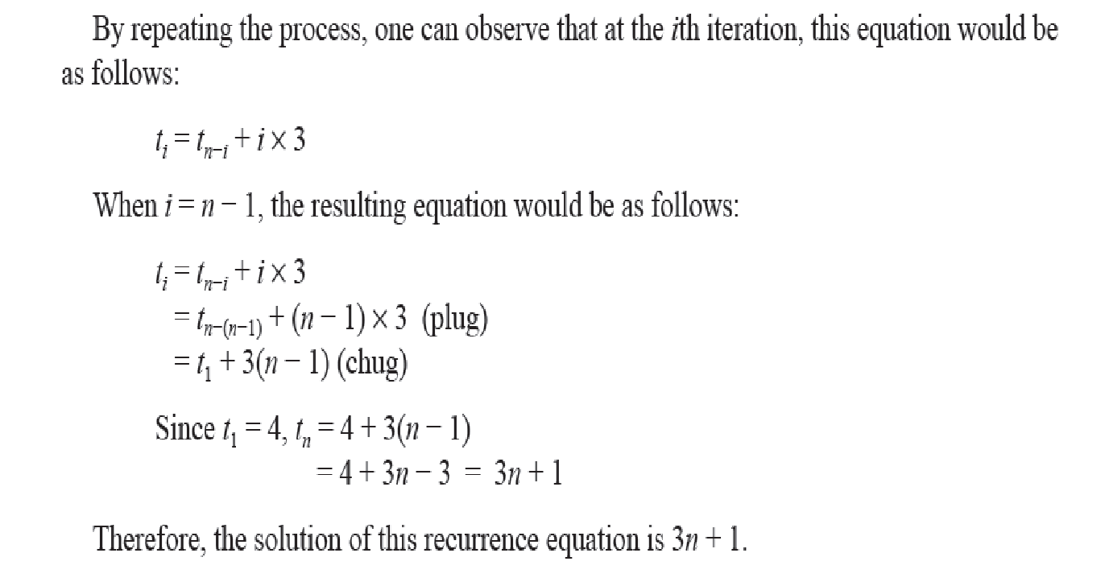

Slide 22
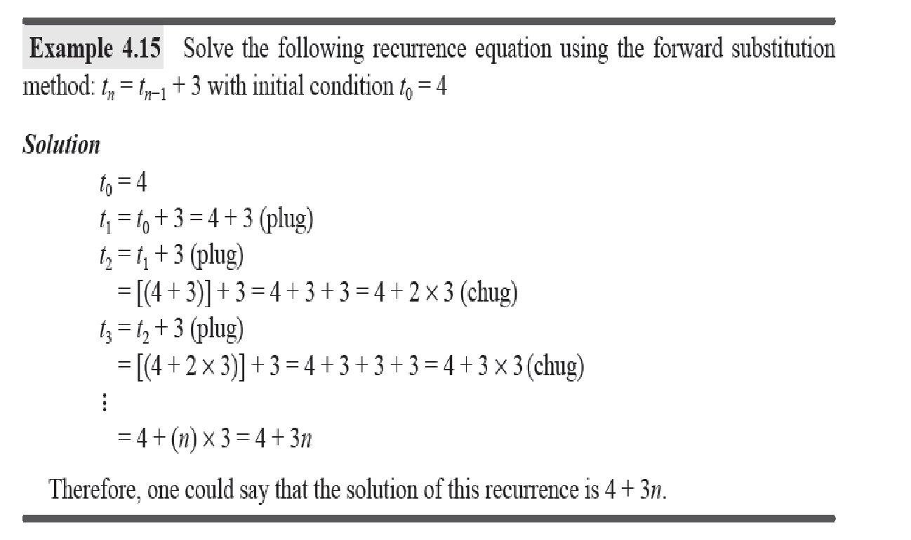
Forward Substitution

Slide 23
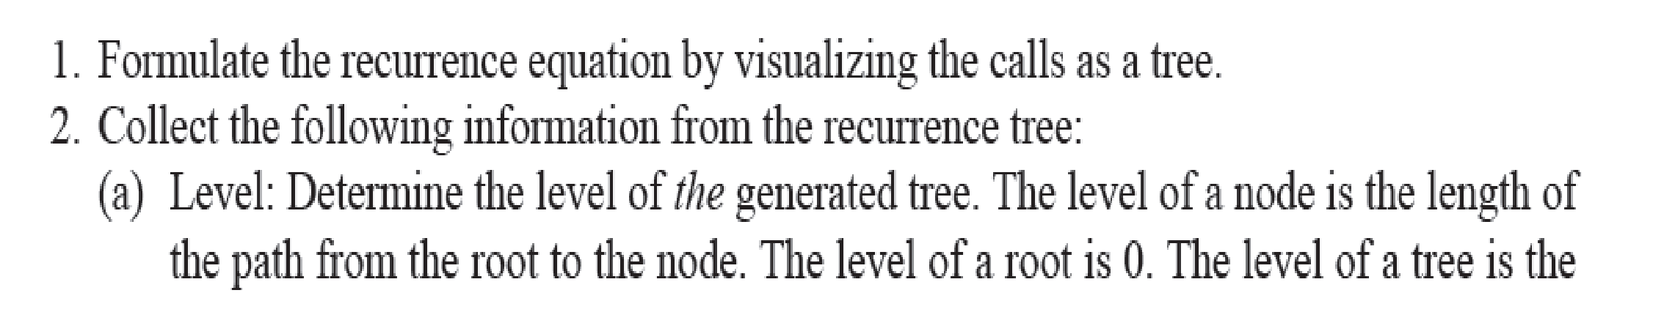
Recurrence Tree Method

Slide 24
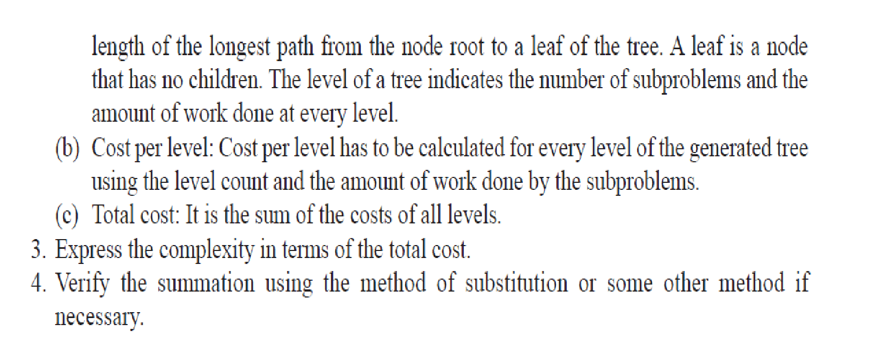
Recurrence Tree Method

Slide 25
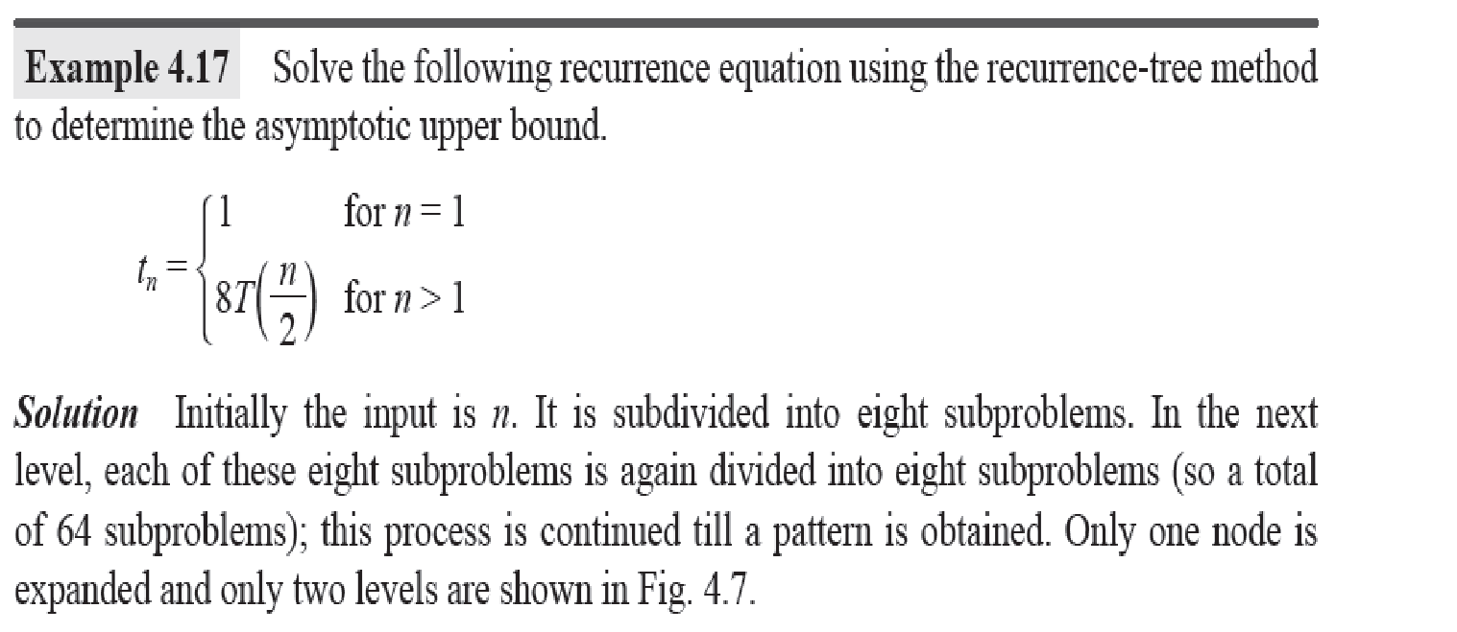

Slide 26
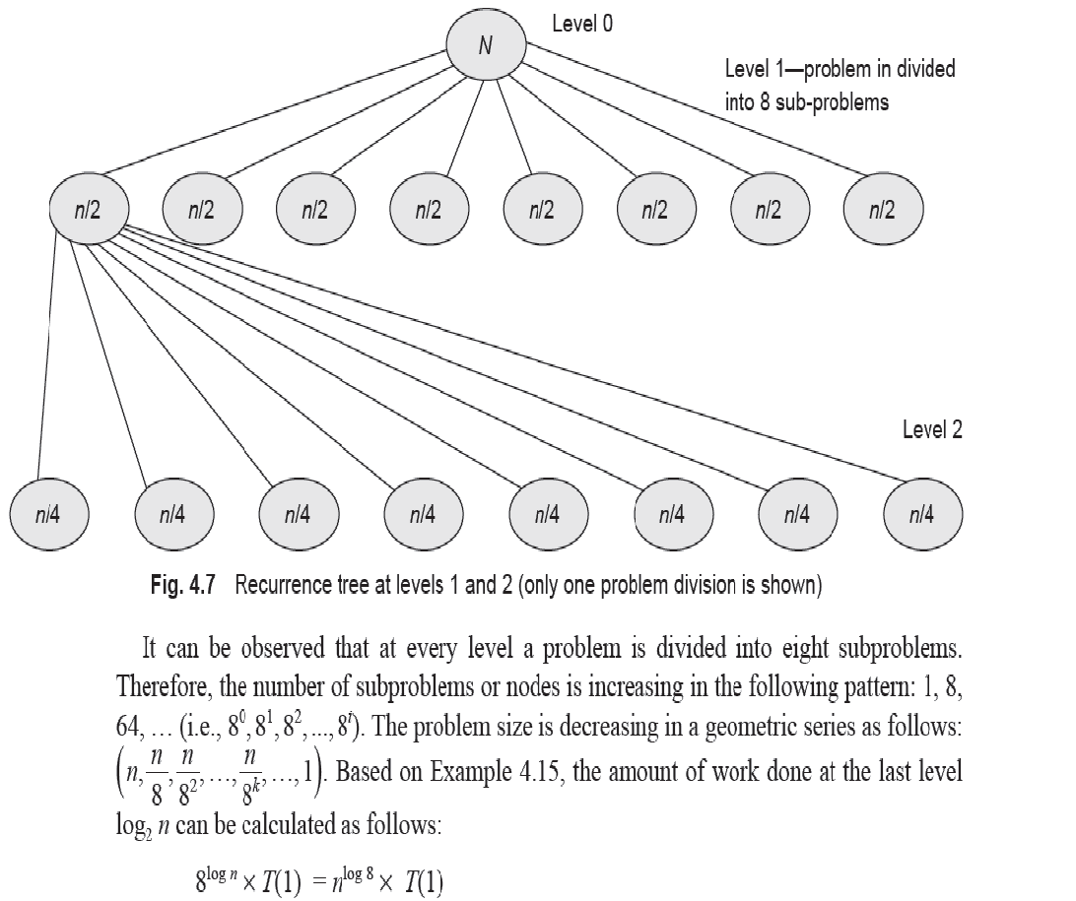

Slide 27
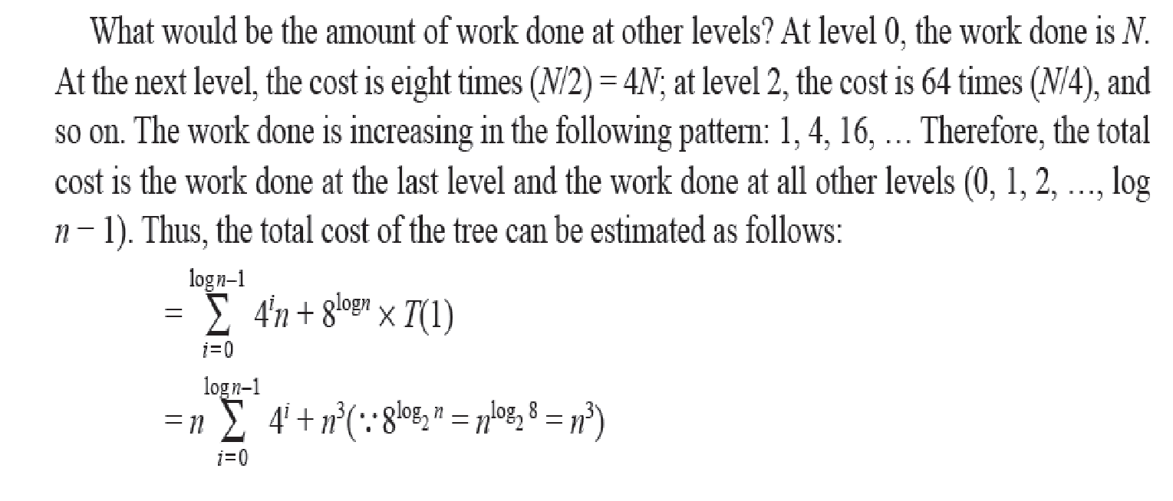
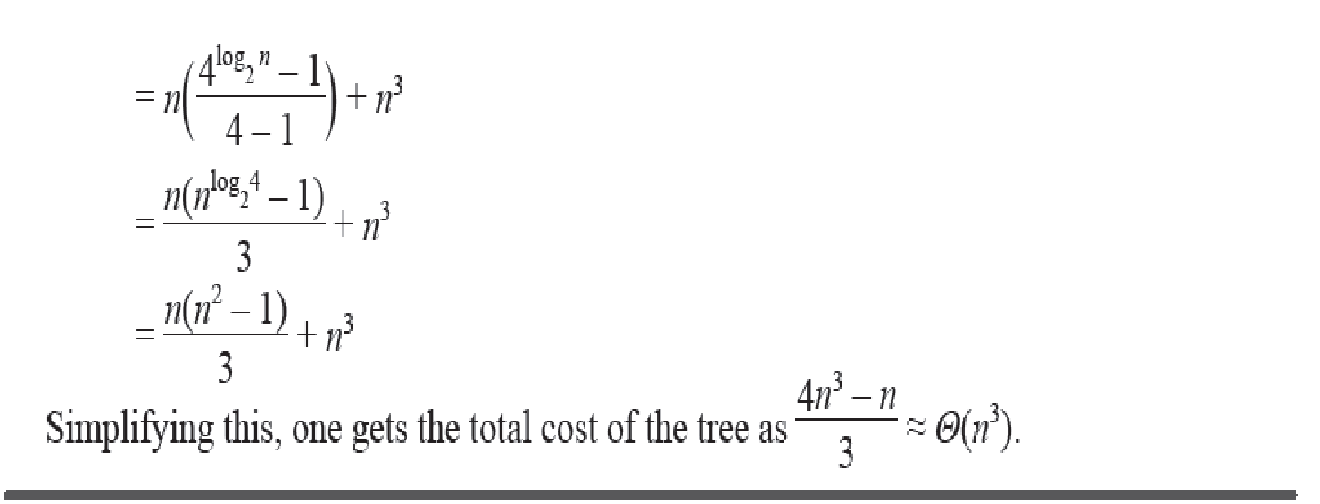

Slide 28
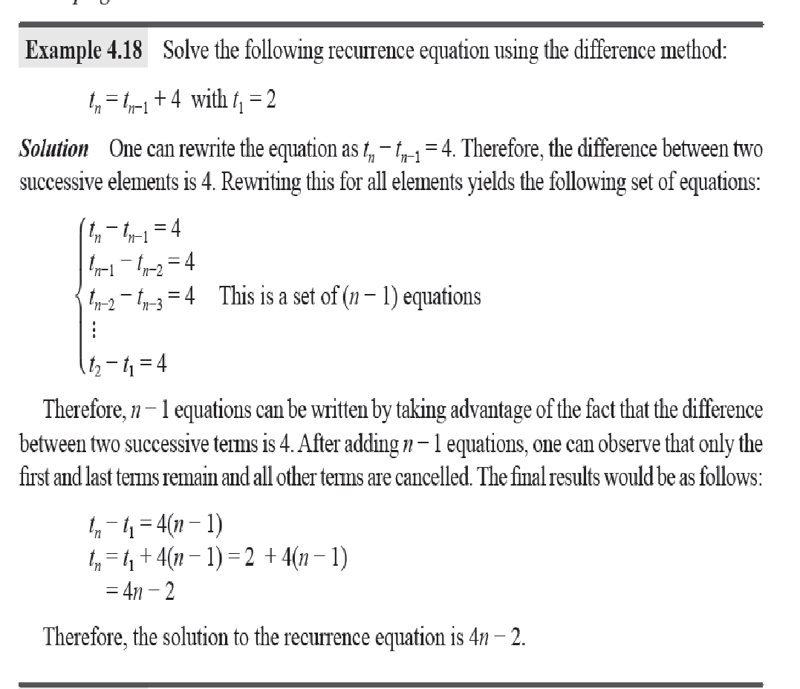
Difference Method

Slide 29
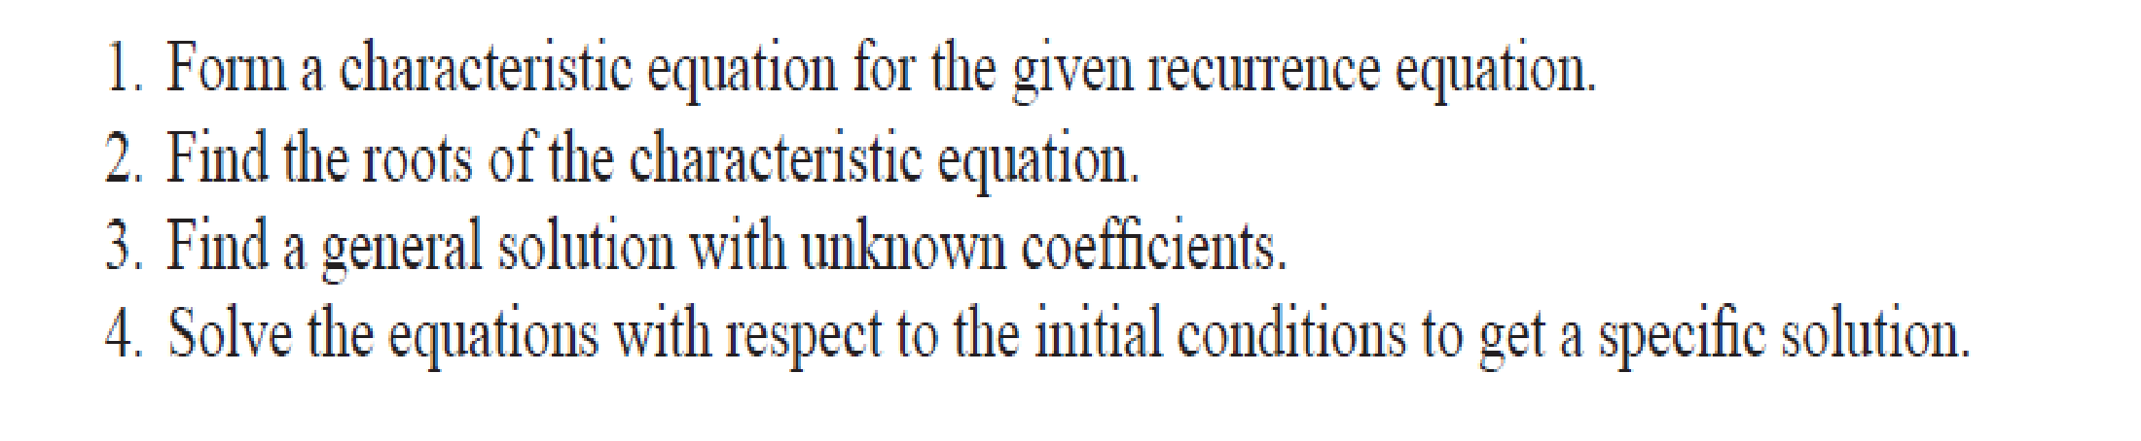
Polynomial Reduction

Slide 30
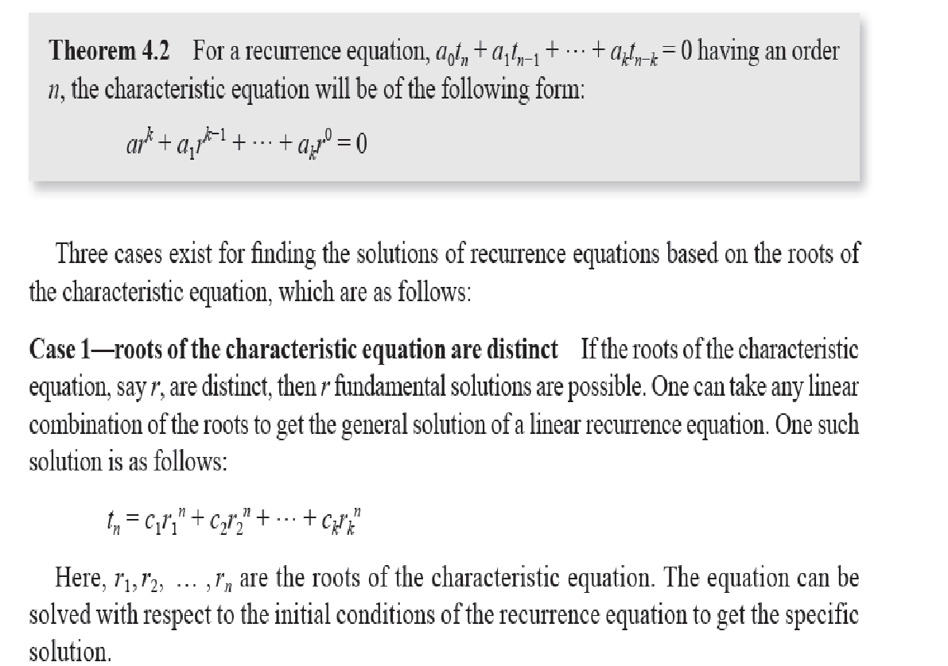

Slide 31
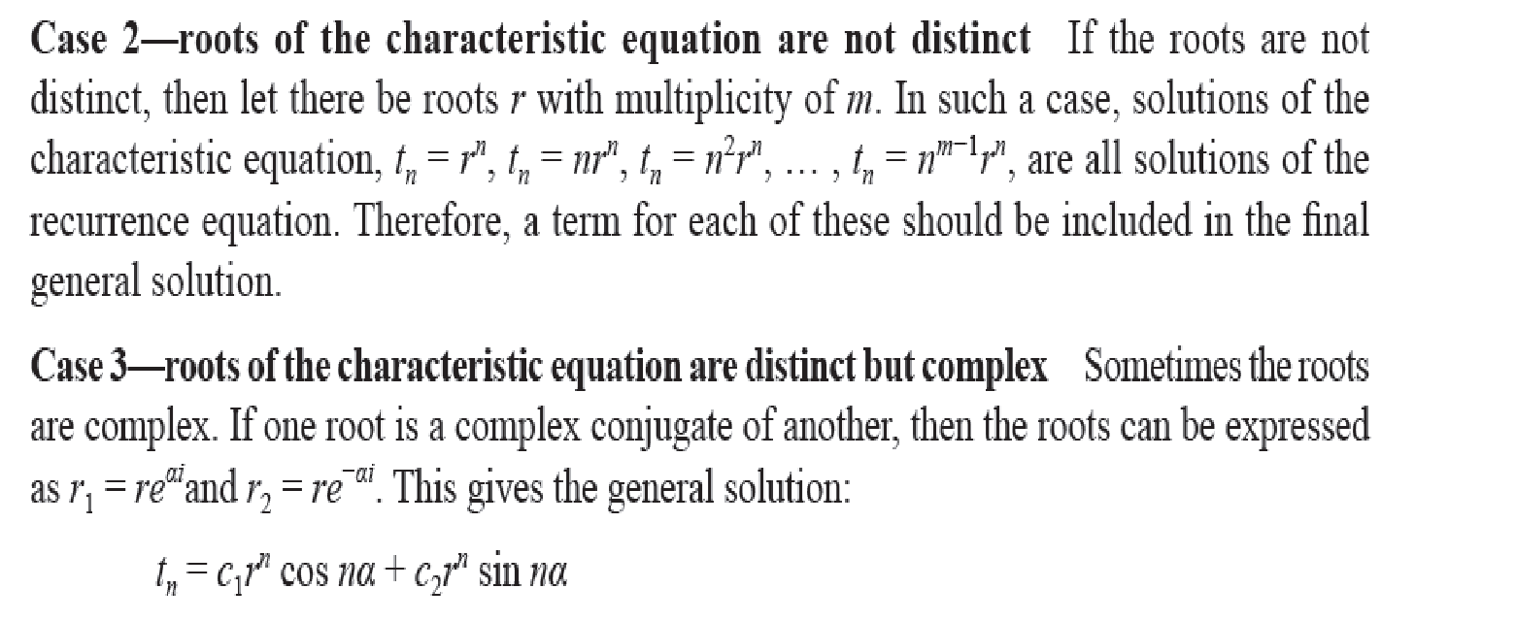

Slide 32
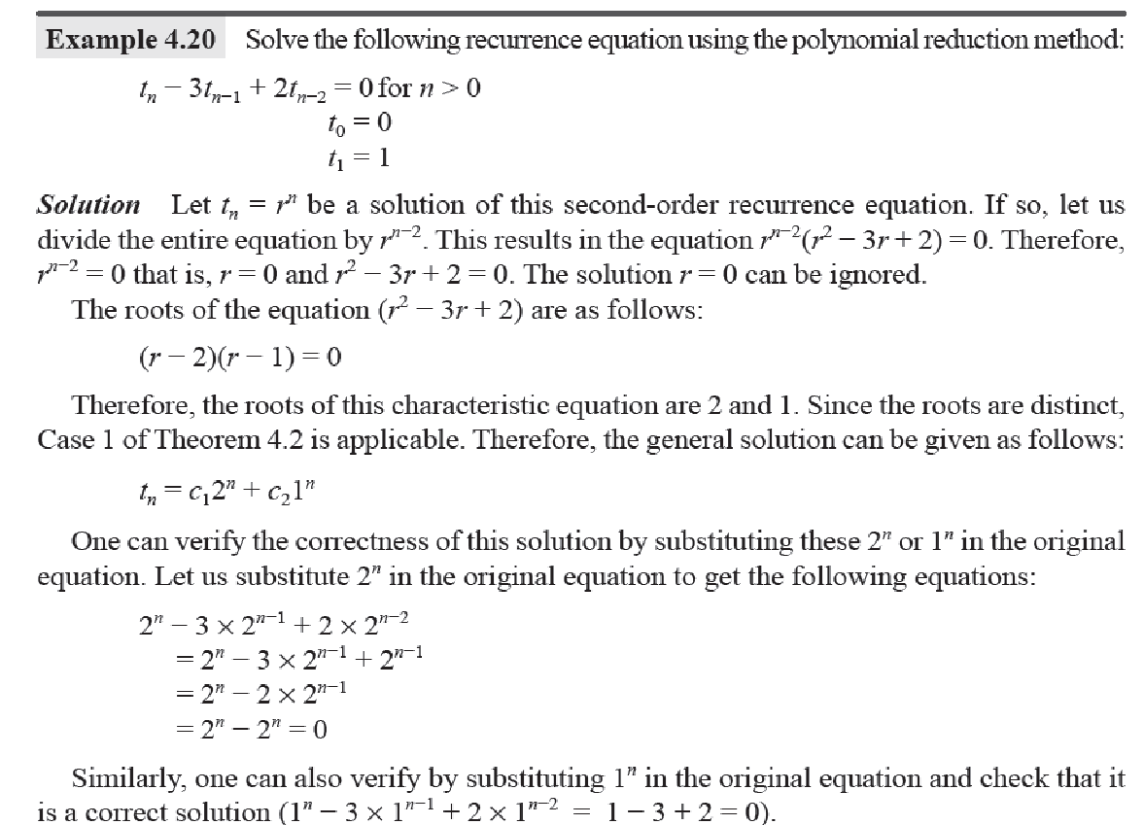

Slide 33
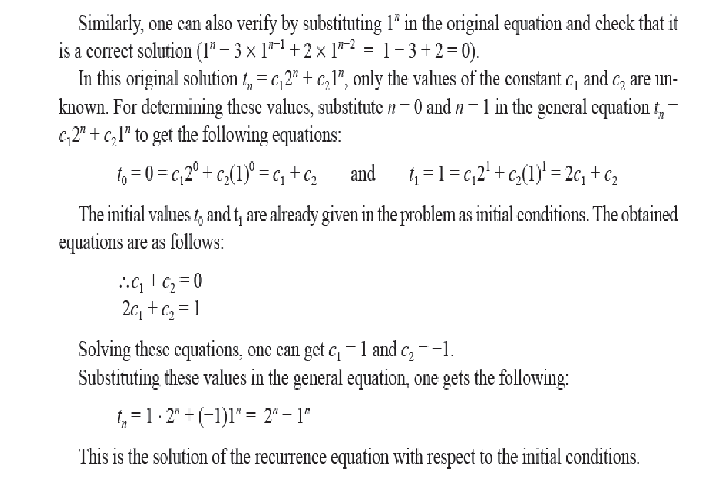

Slide 34
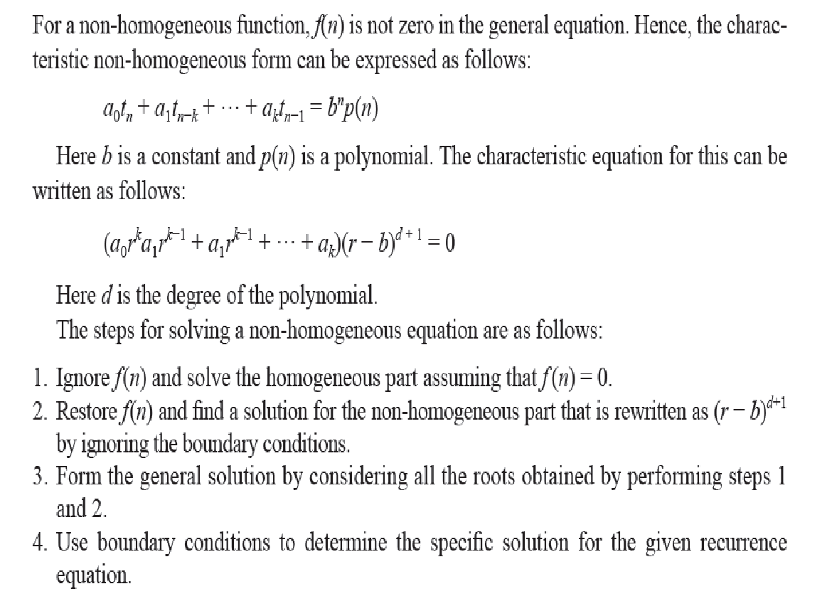
Non-homogeneous Equations

Slide 35
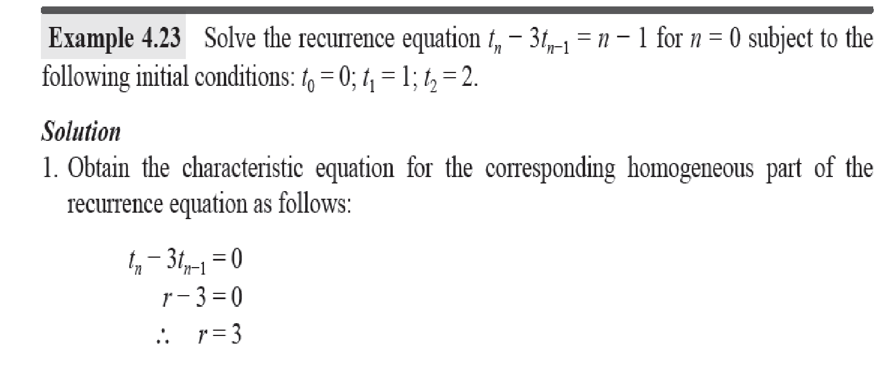

Slide 36
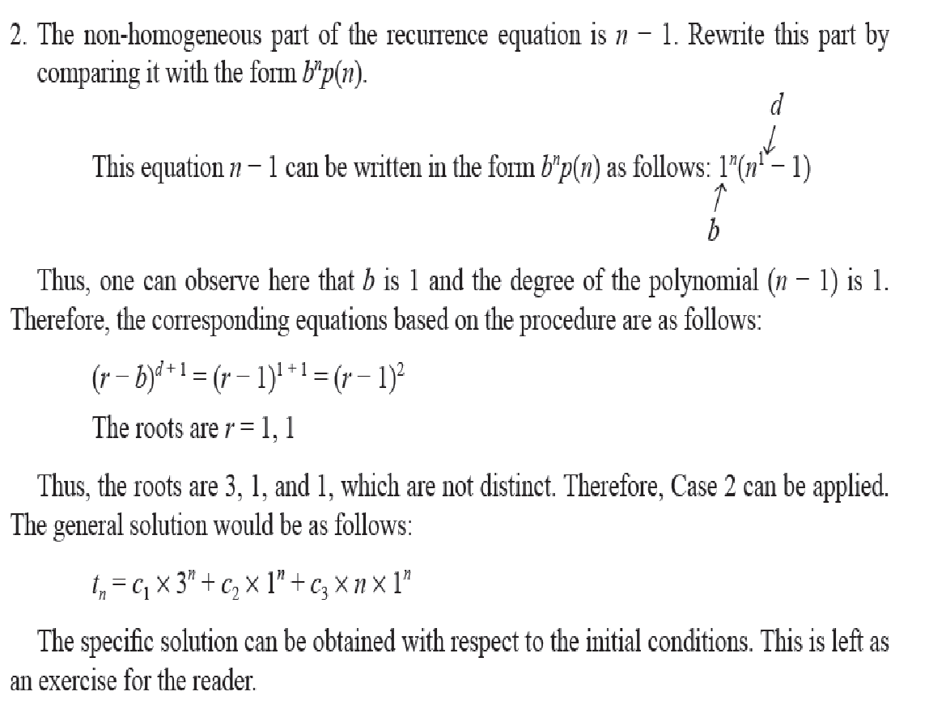

Slide 37
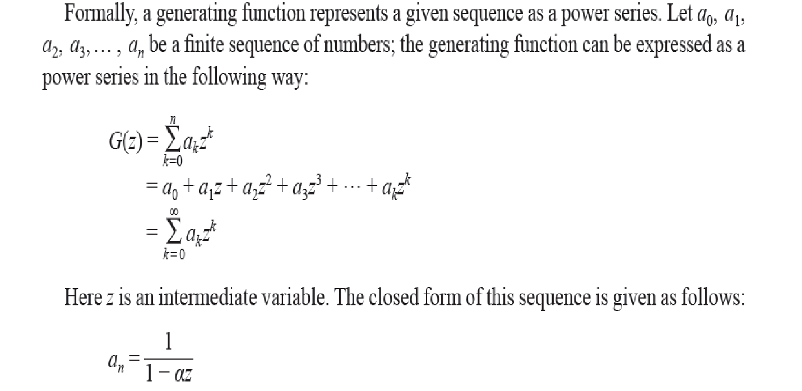
Generating Functions

Slide 38
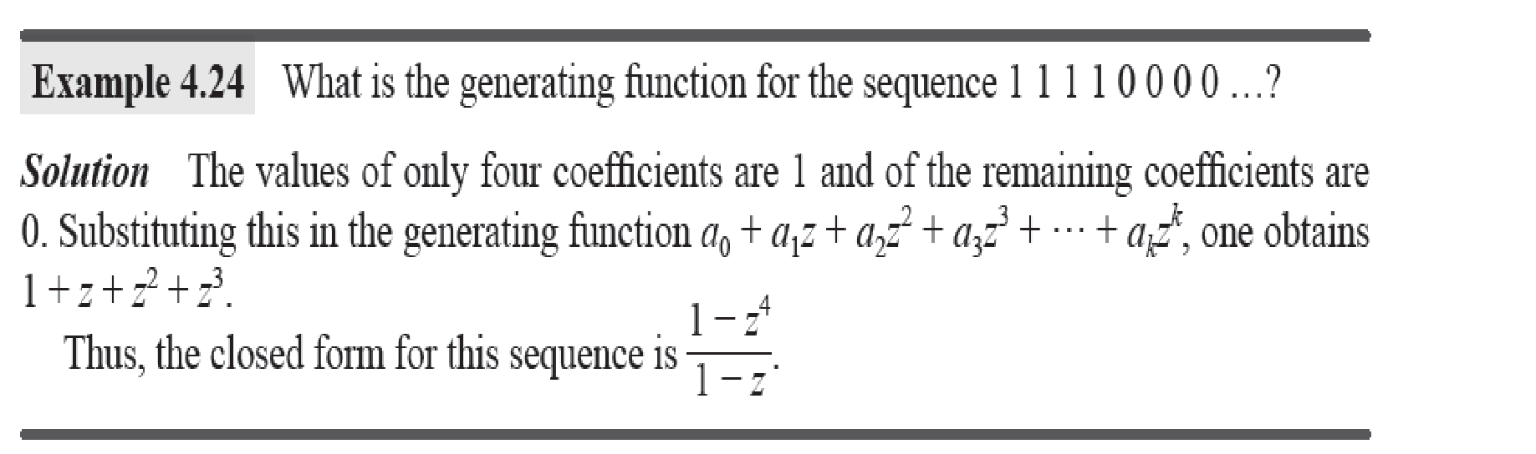

Slide 39
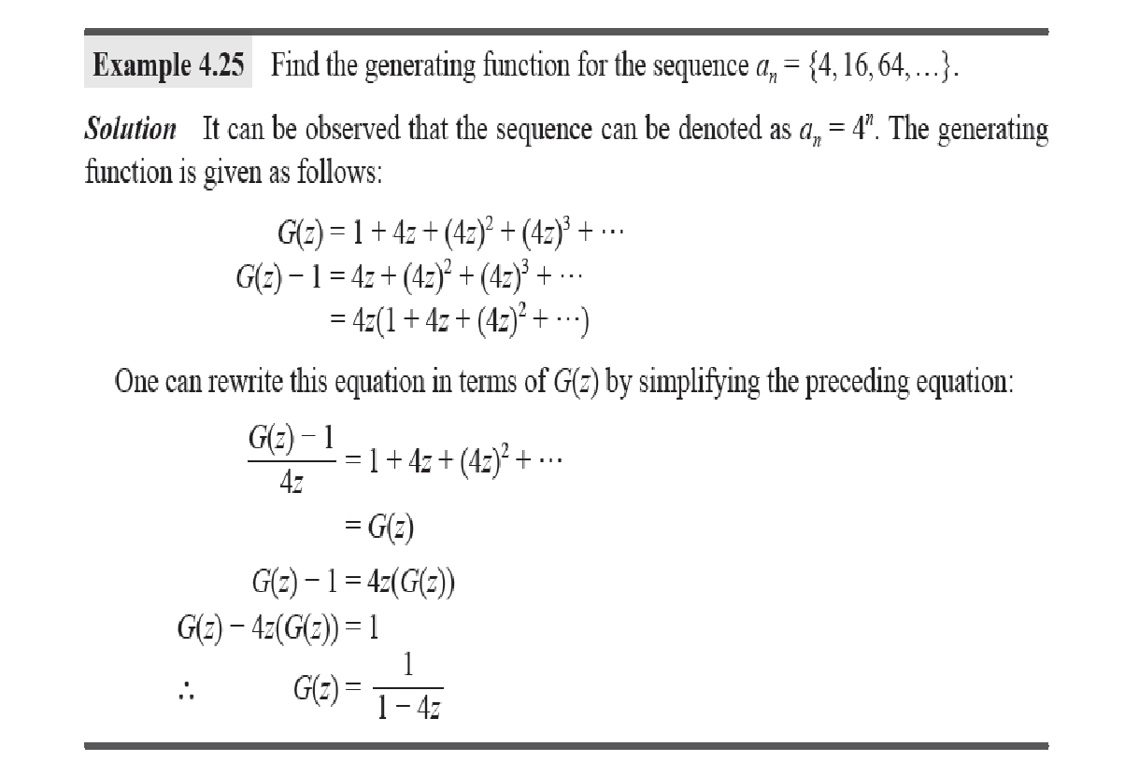

Slide 40
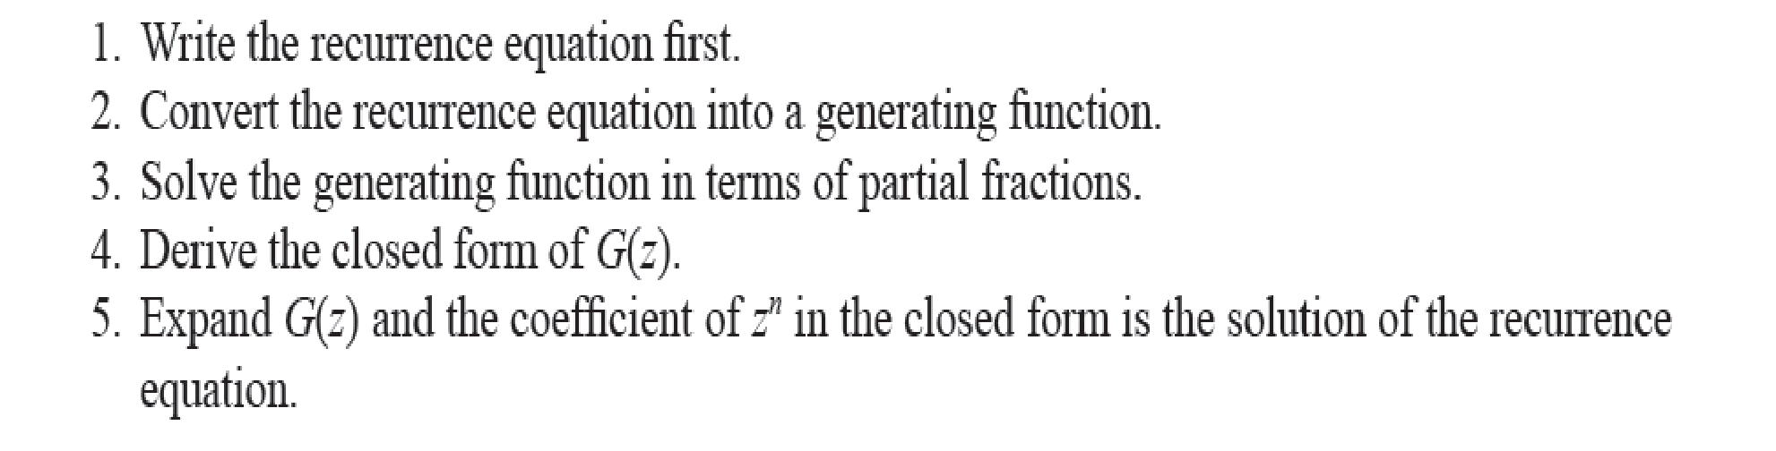
Procedure

Slide 41
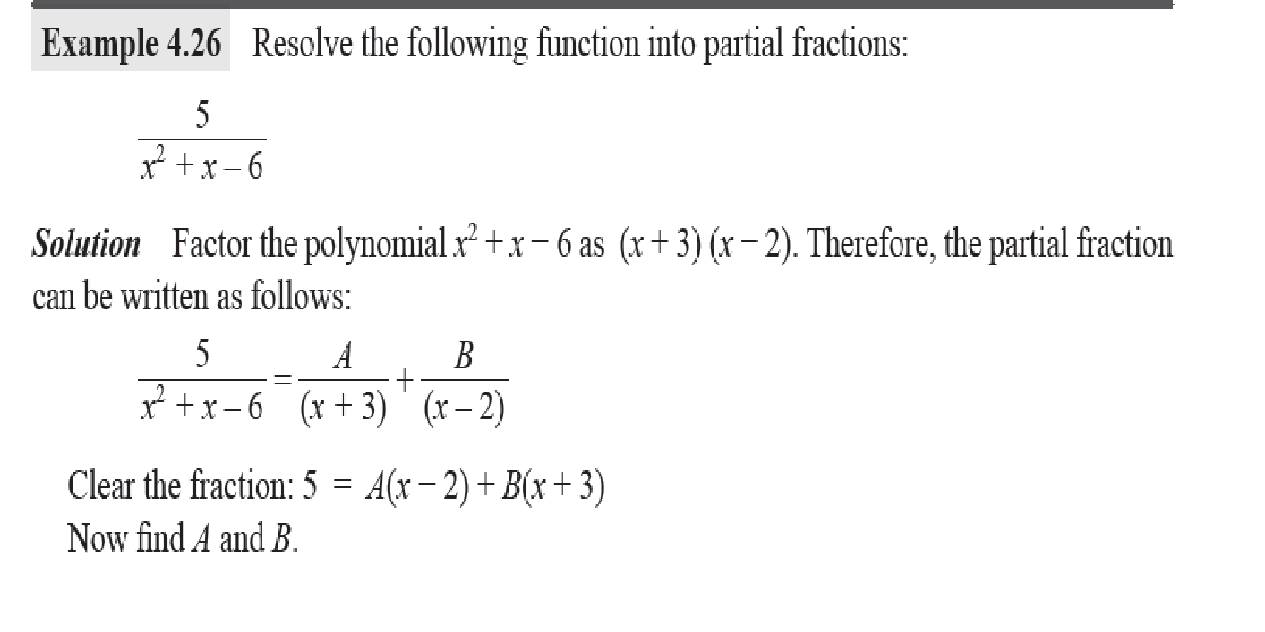

Slide 42
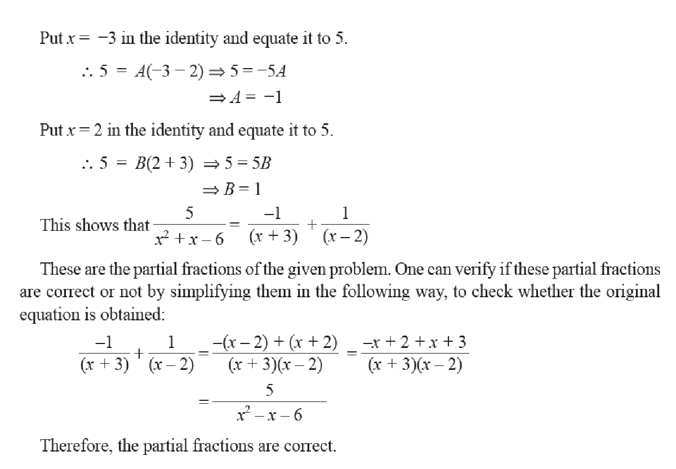

Slide 43
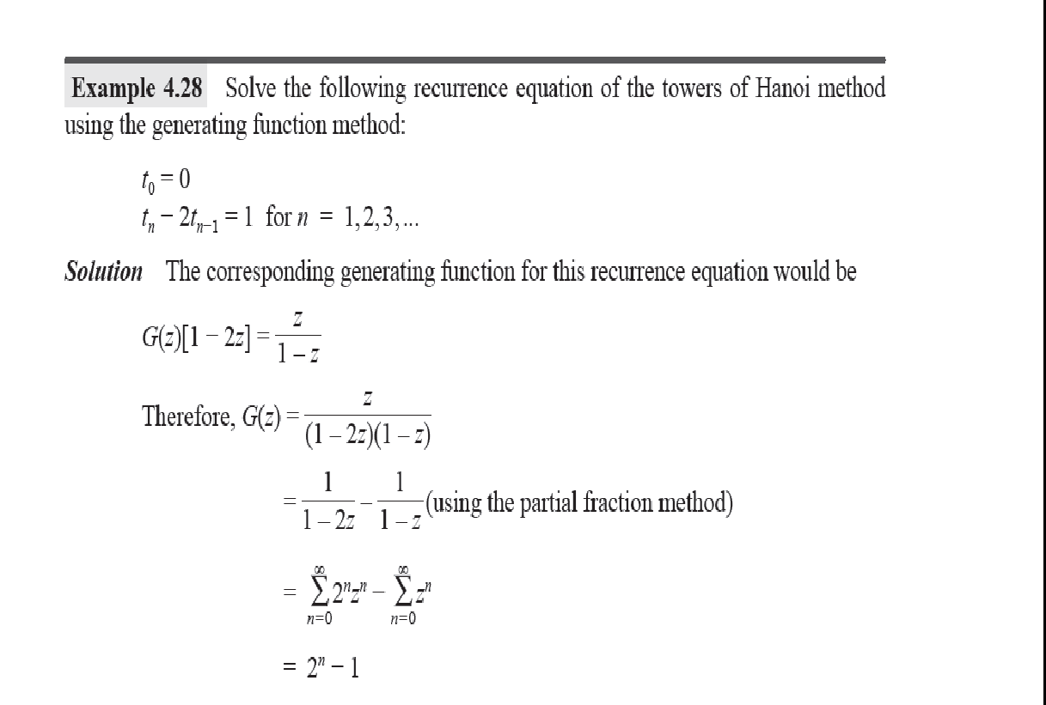

Slide 44
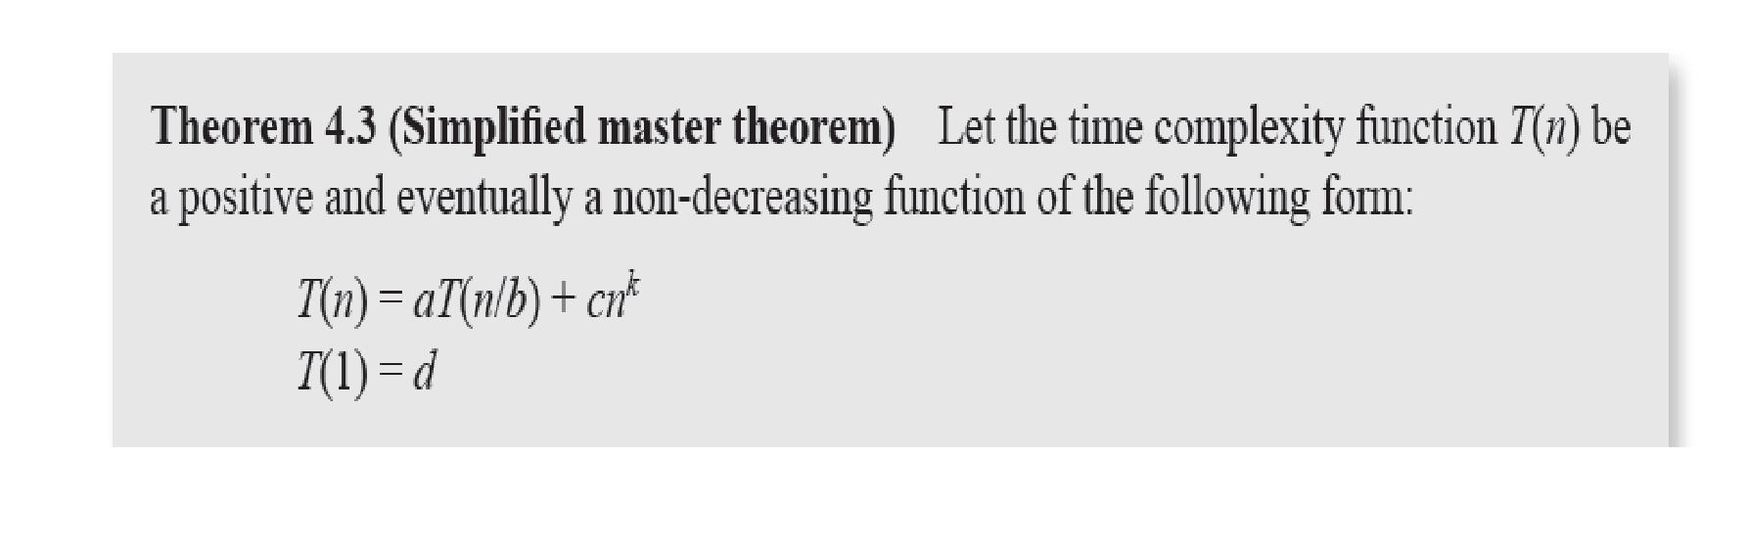
Master Theorem

Slide 45
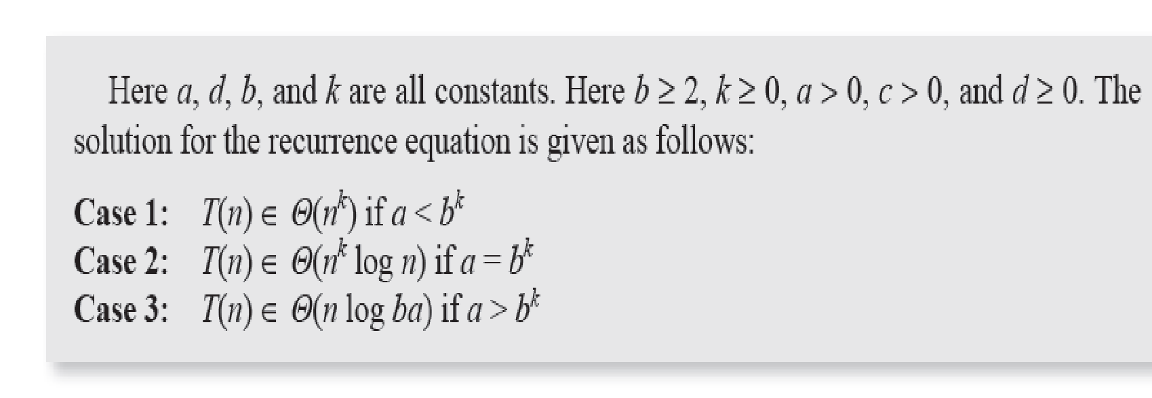

Slide 46
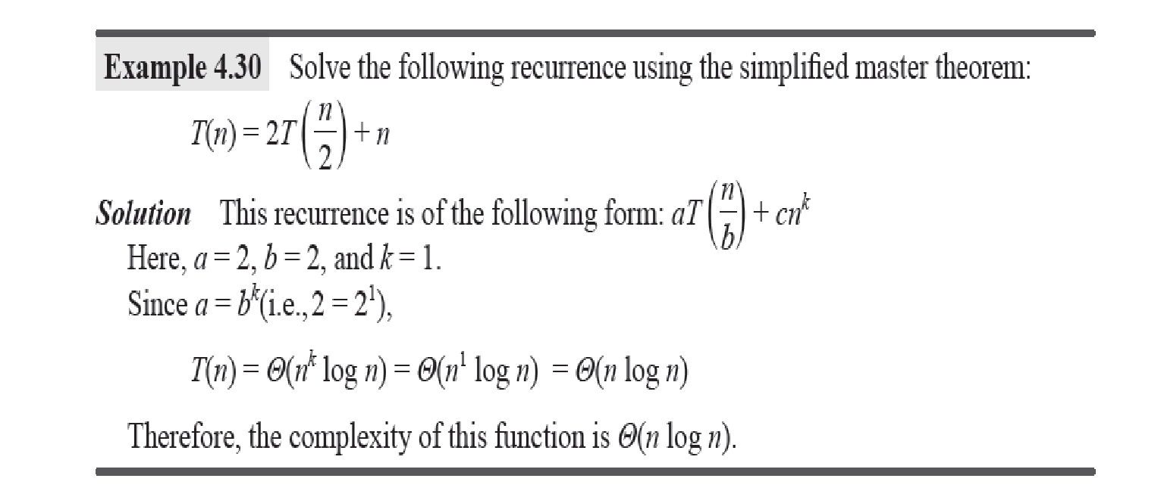

Slide 47
Akra_Bazzi Theorem
Akra–Bazzi Theorem and its Generalization
In 1998, two Lebanon-based researchers provided the solutions for the generalized form of the master theorem, which is as follows:
T(n) = h(n) for 1 ≤ n ≤ n0
aT ( a bk) + f(n) for n ≥ n0
Here, a > 0, b > 1, and n0 ≥ b are integers; h(n) is a function that is in the range d1 ≤ h(n) ≤ d2 for two constants d1 and d2 and 1 ≤ n ≤ n0; and f(n) is a positive polynomial that is in the range c1g(n) ≤ f(n) ≤ c2g(n) for all x > 0 and u ∈ nb , n. If all these conditions are satisfied and the condition a bp = 1 is true, then the solution of the recurrence is given as follows:
T(n) = Θ(np(1 + u∫1 f(u) uP+1 ))
This is a powerful theorem and solves almost all those recurrences that cannot be solved easily by other methods.

Slide 48
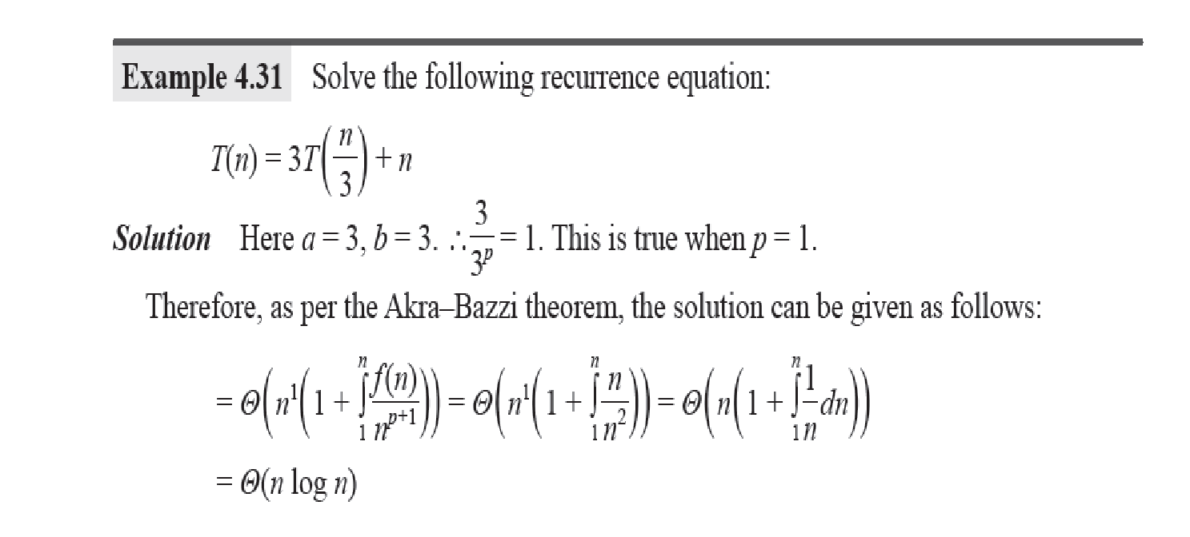
Example

Slide 49
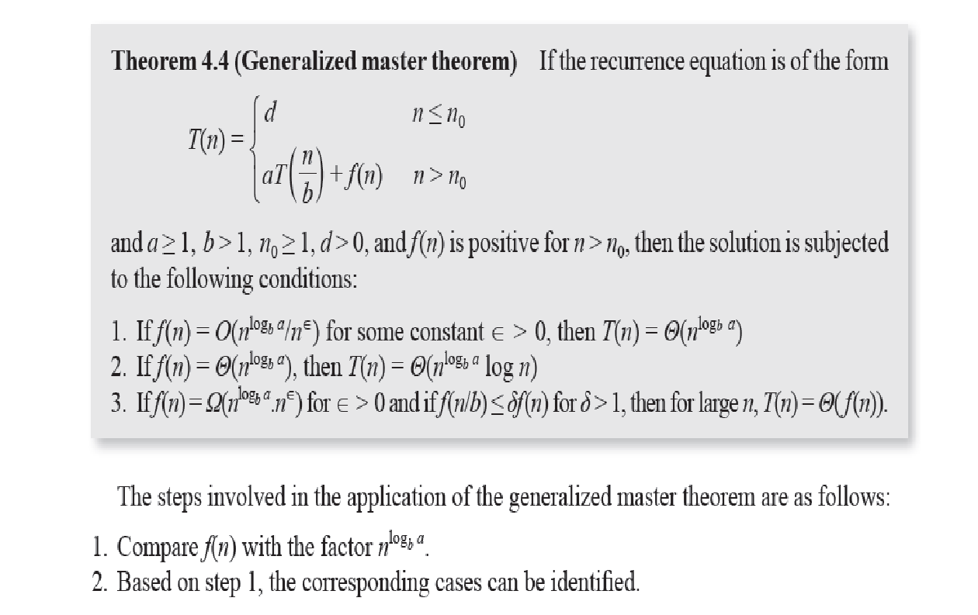
Generalized Master Theorem

Slide 50
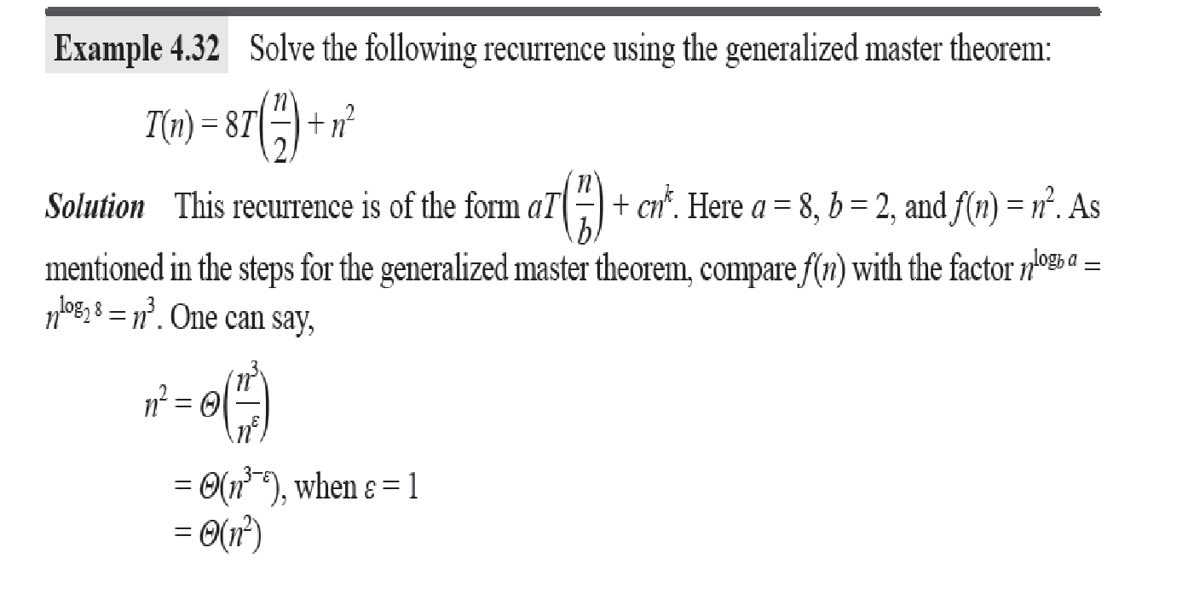
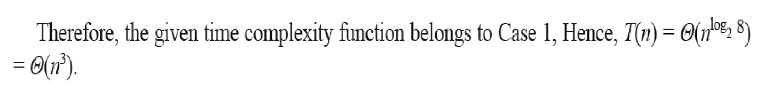

Slide 51
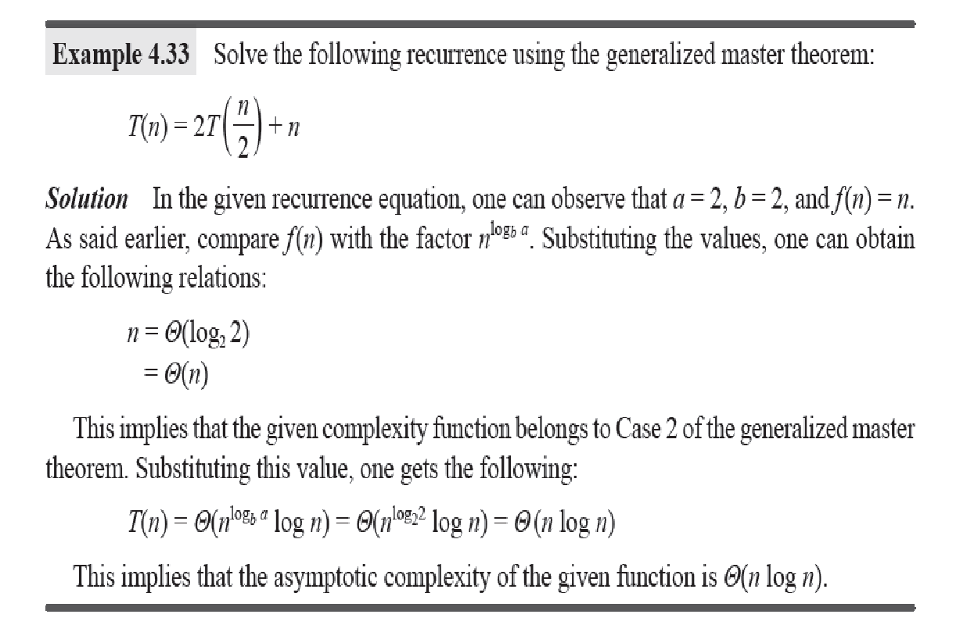
Example

Slide 52
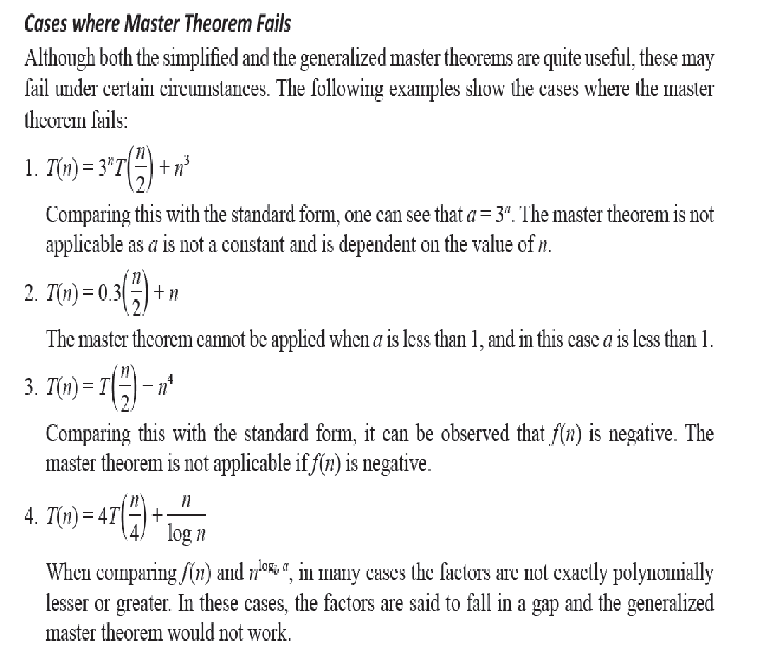
Cases where master theorem fails

Slide 53
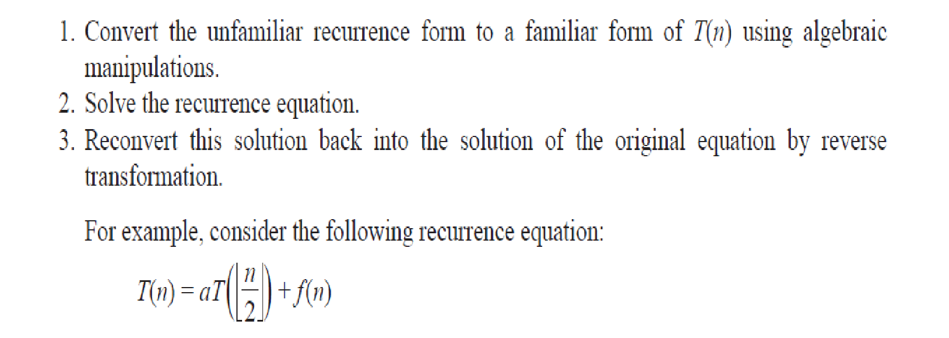
Transformation

Slide 54
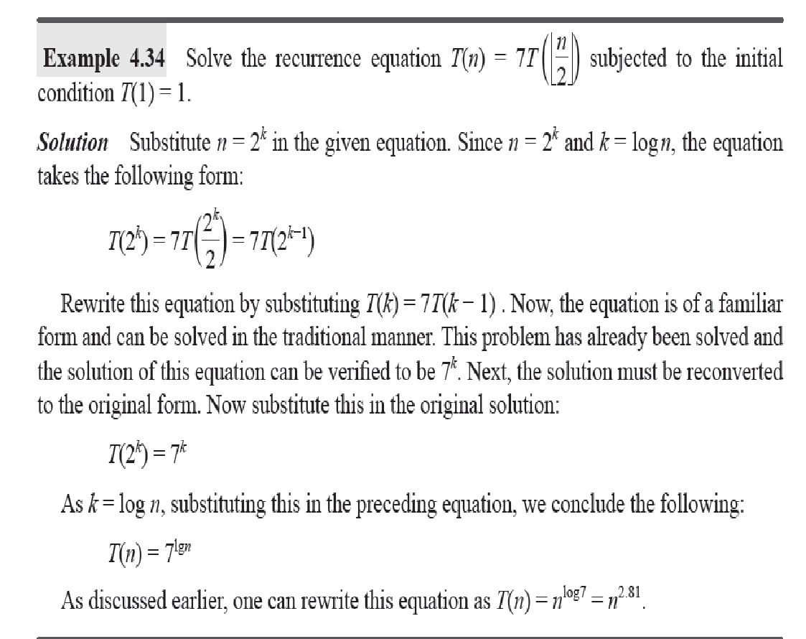
Example

Slide 55
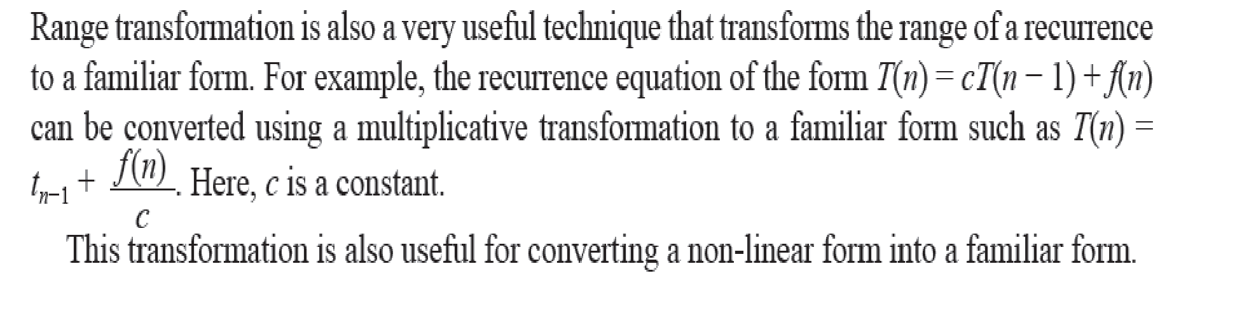
Range Transform

Slide 56
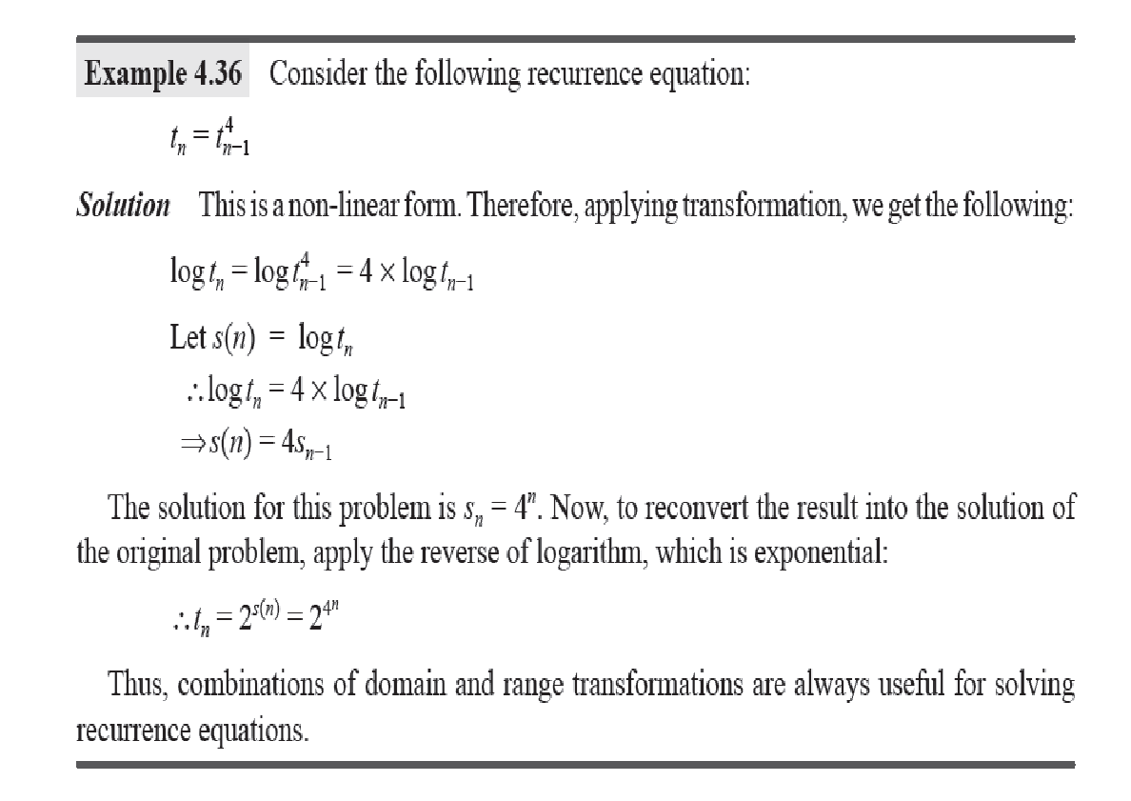
Example

Slide 57
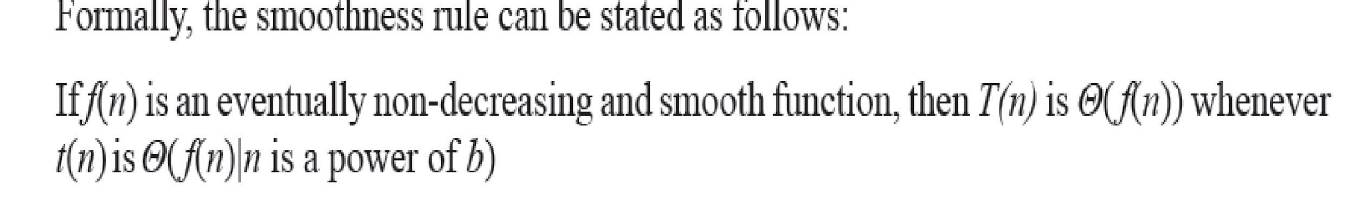
Conditional Asymptotics

Slide 58

Smoothness Rule

Slide 59

Example

Slide 60
Problem..
Find a recurrence relation and initial conditions for
1,5,17,53,161,485….

Slide 61
ind a recurrence relation and initial conditions for
1,5,17,53,161,485….
Notice that these are growing by a factor of 3. Is the original sequence as well?
1⋅3=3, 5⋅3=15,17⋅3=51 and so on. It appears that we always end up with 2 less than the next term.
So a_{n}=3a_{n−1}+2 is our recurrence relation and the initial condition is
a₀=1

Slide 62

Substitution Method (if we know the answer)
How to solve this?
T(n) = 2T( ) + n, with T(1) = 1
Make a guess
e.g., T(n) = O(n log n)
2. Show it by induction
e.g., to show upper bound, we find constants c and n₀ such that T(n) ≤ c f(n) for n = n₀, n₀+1, n₀+2, …

Slide 63
Substitution Method (if we know the answer)
How to solve this?
T(n) = 2T( ) + n, with T(1) = 1
Make a guess
e.g., T(n) = O(n log n)
Show it by induction
Firstly, T(2) = 4, T(3) = 5.
🡺 We want to have T(n) ≤ cn lg n
🡺 Let c = 2 🡺 T(2) and T(3) okay
Other Cases ?

Slide 64



Substitution Method (if we know the answer)
Induction Case:
Assume the guess is true for all n = 2,3,…,k
For n = k+1, we have:
T(n) = 2T( ) + n
= cn lg n – cn + n ≤ cn log n
Induction case is true

Slide 65
Substitution Method (if we know the answer)
Q. How did we know the value of c and n₀ ?
If induction works, the induction case must be correct 🡺 c ≥ 1
Then, we find that by setting c = 2, our guess is correct as soon as n₀ = 2
Alternatively, we can also use c = 1.5 Then, we just need a larger n₀ = 4
(What will be the new base cases? Why?)

Slide 66
Substitution Method (New Challenge)
How to solve this?
1. Make a guess (T(n) = O(n)), and
Show T(n) ≤ cn by induction
What will happen in induction case?

Slide 67

Substitution Method (New Challenge)
Induction Case:
(assume guess is true for some base cases)
This term is not what we want …

Slide 68
Substitution Method (New Challenge)
The 1st attempt was not working because our guess for T(n) was a bit “loose”
Recall: Induction may become easier if we prove a “stronger” statement
2nd Attempt: Refine our statement
Try to show T(n) ≤ cn - b instead

Slide 69

Substitution Method (New Challenge)
Induction Case:
We get the desired term (when b ≥ 1)
It remains to find c and n₀, and prove the base case(s), which is relatively easy

Slide 70

Substitution Method (New Challenge 2)
How to solve this?
T(n) = 2T( ) + lg n ?
Hint: Change variable: Set m = lg n

Slide 71
Substitution Method (New Challenge 2)
Set m = lg n , we get
T(2^{m}) = 2T(2^{m/2}) + m
Next, set S(m) = T(2^{m}) = T(n)
S(m) = 2S(m/2) + m
We solve S(m) = O(m lg m)
🡺 T(n) = O(lg n lg lg n)

Slide 72
Recursion Tree Method ( Nothing Special… Very Useful ! )
How to solve this?
T(n) = 2T(n/2) + n², with T(1) = 1

Slide 73

Recursion Tree Method ( Nothing Special… Very Useful ! )
Expanding the terms, we get:
T(n) = n² + 2T(n/2)
= n² + 2n²/4 + 4T(n/4)
= n² + 2n²/4 + 4n²/16 + 8T(n/8)
= . . .
=
= Θ(n²) + Θ(n) = Θ(n²)

Slide 74

Recursion Tree Method ( Recursion Tree View )
We can express the previous recurrence by:

Slide 75

Further expressing gives us:
This term is from T(n/2)

Slide 76
Recursion Tree Method ( New Challenge )
How to solve this?
T(n) = T(n/3) + T(2n/3) + n, with T(1) = 1
What will be the recursion tree view?

Slide 77

The corresponding recursion tree view is:

Slide 78


